Slide 1
Session 7
Maximal Extractable Value (MEV)
Blockchain Protocols and Decentralized Applications

Slide 2
DeFi
Permissionless
Any financial instrument can be implemented and deployed with a few lines of code
Anyone can use it
Transparent:
Anyone can inspect and verify transactions
Composable

Slide 3
Reasons for DeFi
1.4 billion people who remain unbanked
Cross border inefficiency
send $10 to Asia ⇒ 36% fees
Economies with an unstable fiat currency

Slide 4
MEV - The Problem
Users want to swap tokens (remember Decentralized Exchanges)
Opportunists want to make arbitrage:
Buy EGLD on OneDEX and sell it on xExchange
Demo
What happens when an user posts a Tx to the mempool?
Leaders select the transaction and add it to the current block
An opportunist can
check the mempool;
add its transaction with a higher priority; how?
By paying a greater fee;
Another opportunist can try to front run him. What happens?
This action is now mostly automated by copy-paste bots

Slide 5
MEV - The Consequences
Price Gas Auctions - front-runners compete
Repeatedly submit a Tx with higher and higher maxPriorityFee
Causes congestion (lots of Tx in mempool) and high gas fees
Who suffers the most?

Slide 6
MEV - Centralization
Private mempools
Validators
don’t propagate the txs
Keep to themselves
Result - only a few validators will handle a bulk of txs

Slide 7
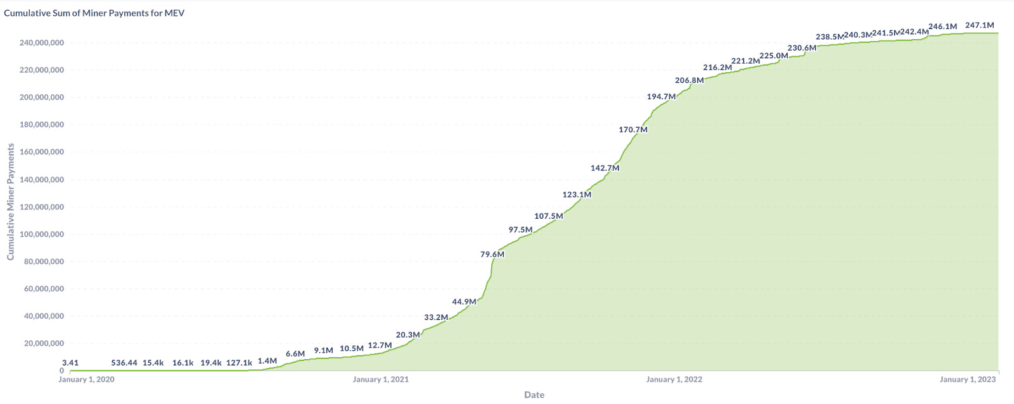
Cumvulative Sum for Miner Payments

Slide 8
What to do?
Accept MEV is unavoidable; minimize its harm to the ecosystem
Ethereum
Try to prevent some MEV
MultiversX
Remove the block proposer’s choice in ordering Tx in a block

